Slide 1
Academic Program Prioritization
SIUE Congress
November 6, 2015

Slide 2
Our Mission and Vision
MISSION
  Southern Illinois University Edwardsville is a student-centered educational community dedicated to communicating, expanding and integrating knowledge. In a spirit of collaboration enriched by diverse ideas, our comprehensive and unique array of undergraduate and graduate programs develops professionals, scholars and leaders who shape a changing world.
VISION
  Southern Illinois University Edwardsville will achieve greater national and global recognition and academic prominence through innovative and interdisciplinary programs that empower individuals to achieve their full potential.

Slide 3
What is Academic Program Prioritization?
Quality?
Opportunities for Growth?
FACULTY-LED BUT INCLUSIVE
PROCESS
Mission Centrality?
Academic Programs
Challenges?
IBHE Program Inventory Includes 132 Records for SIUE
Public Need?
Financial Considerations?
Processes often use quantitative and qualitative data to understand the context, outcomes, and opportunities. Narratives strengthen understandings and these are prepared by faculty with directors, chairs, and deans
Inspired by graphics used in the Portland State University program prioritization materials.
Notes:
We have not collectively identified our academic program priorities. This is critical to meet enrollment, revenue, and quality goals. Likewise, we miss opportunities to support innovation and growth.
What are our current priorities among existing programs?
What are our enrollment priorities?
Where do we need to allocate resources?
What are our priorities for future academic programs?

Slide 4
Then what… (typically)
Careful review
Recommendations (by our campus community)
Action plans
Planning and Budgeting
Alignment
Imple-ment
Notes:
Common Guiding Principles
Data Informed, Institutional Perspective (think like a trustee)
Honor contracts and policies
Guarantee that students can move toward completion effectively

Slide 5
Why prioritize academic programs?
The Congress has been asked to consider how we should prioritize academic programs.
Above all, it is imperative that we develop a collaborative and fair process to identify our collective academic priorities.

Slide 6
Potential Outcomes of a Prioritization Process
Refine and focus our academic programs to support our mission and vision.
Align planning and budgeting with our collective academic priorities.
Support academic programs by assuring that they have the resources to support their goals and activities.
Support programs that have unrealized potential by collectively identifying our goals and commitments.

Slide 7
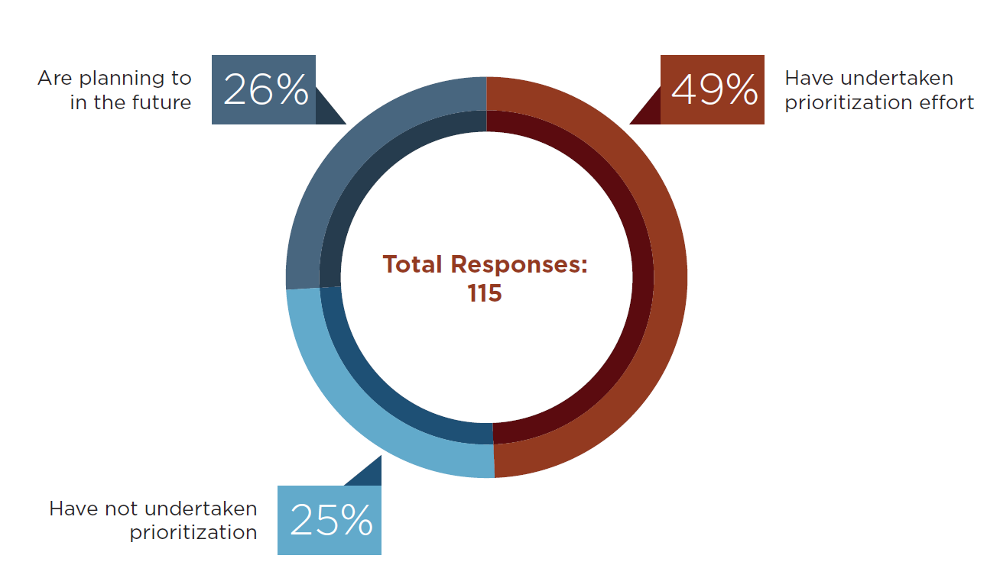
Broader context
March 2013, Academic Impressions Survey
https://www.academicimpressions.com/news/meeting-challenge-program-prioritization-full-report

Slide 8
Broader Context
Increasing pressure from external groups to examine “low performing programs”.
Program prioritization provides an opportunity to support programs that might otherwise be vulnerable.
There is no external mandate for prioritization, but we need to be ready to define our own future – together.

Slide 9
Dickeson’s criteria
Program Priorities
History
External Demand
Internal Demand
Quality of Inputs/
Processes
Quality of Outcomes
Size/Scope/
Prod.
Revenue Generated
Opportunity
Program Costs
Impact/
Essentiality

Slide 10
Many Modifications of Criteria
(Example – Boise State University)
Program Priority
Quality
Efficiency
Opportunity Analysis
Relevance
Notes:
NIU – Uses Importance to the University, External and Internal Demand, Quality, Cost Effectiveness and Opportunity Analysis

Slide 11
Demand | Quality | Costs and Expenses | Opportunity
IPEDS Reports | Measures of Graduate Satisfaction | Total cost per FTE student | Revenue Potential
Incoming Transfers | Program Retention | Allocation | “Signature” program or poised for national recognition
U.S. Department of Labor Projections, etc. | Program Graduation Rates | Required expenses of the program | Unique/Niche Program
Employer Feedback | Job placement and Success | Marginal Costs | Previous Innovations
State/Regional Needs | Success rates on certifications and exams | Comparative Costs | External Partnership Potentials
Contributions to Other Programs | Faculty Recognition for Scholarly or Service Contributions | Revenue generated through tuition, grants, ICR, clinics, online programs, etc. | Interdisciplinary Possibilities
Offer to Acceptance Trends | Recognition and Awards | Fundraising outcomes | Opportunity to realign or strengthen existing
Competition | Student Learning Outcomes |  | Key Stakeholders are Invested
From Dickeson (2010) , Prioritizing Academic Programs and Services as cited in Appalachian State University, PPT Higher Education Impact

Slide 12
Example Recommendations for Action
(NIU Examples)
Enhanced Resources
No Changes in Resources
Continue with Reduced Resources
Requires Transformation
Candidate for phase out or Consider for Further
Review
Notes:
Retain and Enhance; Monitor and Address Issues; Realign, Reorganize or Integrate; Eliminate
Maintain, Transform, Further Review Needed
Poised to Move to National Excellence; Capacity to Increase Research and Scholarly Productivity, Capacity to Increase Service Mission, Poised to help add degrees; Programs with insufficient enrollment or productivity to justify continuing in their current state

Slide 13
Lessons Learned
Shared governance
Faculty-driven
Inclusivity
Open and transparent processes
Data-informed
Clear goals determined from the beginning
Notes:
Shared governance
Engage existing governing bodies, create a process that brings in key stakeholders, and engages departments and academic units.
Task forces are populated in different ways (peer nominations, committee configurations utilizing appointees from units and constituency groups)
Inclusivity
Programs, Departments, and Schools/Colleges must have venues to participate and respond for their programs.
Diversity in perspectives
Open and transparent processes
Frequent and multi-faceted communication
Evaluation criteria and processes set by the campus-community
Data-informed
The process should be evidence-informed but solely data-driven approaches may miss issues of mission centrality, interconnectedness, legacy, or importance to the University’s identity.
Both qualitative and quantitative measures.
Clear goals determined from the beginning
Outcomes align with the University’s mission, state/national needs, and stakeholder needs.
Decisions should align with strategic budgeting.
Commonly recommended to keep funds within academic programming and not diverted to other areas.

Slide 14
Examples and References
Appalachian State - http://irap.appstate.edu/institutional-research/program-prioritization
Boise State University http://president.boisestate.edu/prioritization/
East Carolina University http://www.ecu.edu/cs-acad/ppc/
Indiana State - http://www.indstate.edu/academicaffairs/program_prioritization.htm
Northern Illinois University http://niu.edu/program-prioritization/criteria/index.shtml
Portland State University - http://pdxappc.blogspot.com/
University of Minnesota – Duluth - http://www.d.umn.edu/vcaa/Prioritization_academic.pdf
Western Carolina - http://www.wcu.edu/WebFiles/PDFs/Provost_PPTF_Criteria_Draft_for_Initial_Program_Assessment.pdf
Notes:
Based on offering 18 courses.

Slide 15
Other References
Dickeson, R.C. (1999). Prioritizing academic programs and services: Reallocating resources to achieve strategic balance. San Francisco: Jossey-Bass Publishers.
Dickeson, R.E. (2010). Prioritizing academic programs and services: Reallocating resources to achieve strategic balance (2nd edition). Jossey-Bass, San Francisco.
Eckel, P. (2000). The role of shared governance in institutional hard decisions: Enabler or antagonist? The Review of Higher Education, 24(1), 15 – 39.
Fusch, Daniel, “Securing New Resources in a Difficult Financial Climate,” Academic Impressions Higher Ed Impact, October, 2010, pp. 6, 11. Available at www.academicimpressions.com/news
Lederman, Doug, “The Pressure to Prioritize,” Inside Higher Ed, November 11, 2010.

Slide 16

If we want to preserve our core commitments, sustain what matters most, and set a plan for how we will grow intentionally, we must do that together.

Slide 17
Sub-Questions for Tables
What data (quantitative and qualitative) would be most critical for an academic program prioritization process at SIUE?
How should a committee or task force be developed to design and implement a program prioritization process? (Consider representation, size, relationship to constituency groups, and ground rules).
What recommendations regarding a framework or guiding principles are critical for forming a task force or committee?
What are the other major issues, concerns, or considerations that would need to be addressed to create a meaningful, fair, and productive process?

